Slide 1

Assignment no. 02
31. Maximum weight Independent set graphs
32. Minimum operations add 1 multiple of 2
Submitted by
Asna Shahid
SP25-RCS-002
Advanced Algorithms Analysis and Design

Slide 2
Maximum Independent Set (MIS) in Graphs
Independent set
In a graph, an independent set is a set of vertices such that no two vertices are adjacent (i.e., no edge connects any two of them).
Maximum Independent Set (MIS)
Among all independent sets in a graph, the maximum independent set is the one with the largest number of vertices.
formally
Given graph G=(V,E)G = (V, E)G=(V,E).
Find subset S⊆VS \subseteq VS⊆V such that:
For all u,v∈Su, v \in Su,v∈S, (u,v)∉E(u, v) \notin E(u,v)∈/E.
∣S∣|S|∣S∣ is maximized.
Advanced Algorithms Analysis and Design

Slide 3
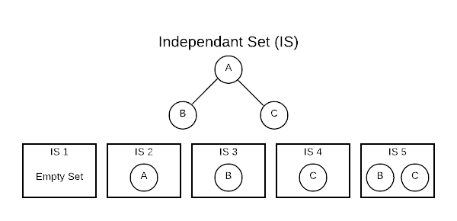
Maximum Independent Set (MIS) in Graphs
Conceptually, an Independent Set (IS) is comparable to the inverse of a graph. It’s a set of vertices that do not contain both endpoints of any edge. Consider a connected graph with only three vertices as shown below. There are five independent sets.
Advanced Algorithms Analysis and Design

Slide 4

Maximum Independent Set (MIS) in Graphs
The [] (empty set) is always considered an IS because it technically fits the definition. The sets [A], [B], and [C] are also ISs because no edge contains only one vertex. The set [B, C] also qualifies because there are no edges connecting B and C. One important thing to note is that the number of ISs grows exponentially as the number of vertices grow. This has important algorithmic implications.
At first glance, this concept seems a bit academic; however, ISs are useful in practice. Finding an IS is a way of asking, which vertices do not have a relationship. For instance, if vertices are people and edges are familial relationship, an IS would define people who are not related.
A path graph has vertices that can be listed in order v1,v2,…,vn such that edges are vi,vi+i where i=1,2,…,n−1. That is rather complicated definition for a simple concept that is easily visualized. The image below represents a path graph. By this definition, there will always be n−1 edges.
Advanced Algorithms Analysis and Design

Slide 5
Correctness of Algorithm
The Maximum Weight Independent Set (MWIS) problem requires selecting vertices such that no two are adjacent, while maximizing the sum of their weights.
Dynamic Programming (DP) ensures correctness because it explores all valid possibilities in a structured way and uses the optimal substructure property of the problem.
Case: Path Graphs
For a vertex at position i, two possibilities exist:
Exclude vertex i
  Then the optimal solution is simply the best solution up to i-1.
  Value = MWIS(i-1).
Include vertex i
Then vertex (i-1) cannot be included (independence property).
Value = w[i] + MWIS(i-2).
Recurrence Relation:
MWIS(i)=max(MWIS(i−1),w[i]+MWIS(i−2))
Advanced Algorithms Analysis and Design

Slide 6
Correctness of Algorithm
Correctness by Induction:
Base case: For 0 or 1 vertices, the recurrence clearly gives the correct result (weight 0 or weight of the single vertex).
Inductive step: Assume recurrence is correct for i-1 and i-2. For vertex i, the recurrence explicitly checks both valid choices (include or exclude). Since it always picks the maximum, the solution is guaranteed to be optimal.
Advanced Algorithms Analysis and Design

Slide 7
Pseudocode (MWIS on Path Graph)
Algorithm MWIS_Path(w[1..n]):
# w[i] = weight of vertex i in path graph
# DP[i] will store maximum weight of MWIS up to vertex i
DP[0] = 0 # no vertices
DP[1] = w[1] # only one vertex
for i = 2 to n:
# Two choices:
# 1. Exclude vertex i → take MWIS up to i-1
# 2. Include vertex i → add w[i] + MWIS up to i-2
DP[i] = max(DP[i-1], w[i] + DP[i-2])
return DP[n]
Advanced Algorithms Analysis and Design

Slide 8
Correctness of Algorithm
Correctness by Induction on Tree Height:
Base case: A leaf node is correct (Include = its weight, Exclude = 0).
Inductive step: Assume correctness for all subtrees rooted at children of u. Then the recurrence at u correctly captures the two possible cases (include/exclude). By always choosing the maximum, the algorithm constructs an optimal solution.
Therefore, Tree DP always gives the correct MWIS.
Advanced Algorithms Analysis and Design

Slide 9
Correctness of Algorithm
2 .Case: Tree Graphs
For a node u, two possibilities exist:
Include u → all its children must be excluded.
Include(u)=w[u]+v∈children(u)∑​Exclude(v)
Exclude u → each child can be either included or excluded, whichever is better.
Exclude(u)=v∈children(u)∑​max(Include(v),Exclude(v))
Advanced Algorithms Analysis and Design

Slide 10
Tree Graph MWIS example
A(5)
/ \
B(3) C(4)
/ \ / \
D(2) E(1) F(6) G(1)
DP values (compute bottom-up)
Calculate Include(node) and Exclude(node) where:
Include(u) = w[u] + sum(Exclude(child))
Exclude(u) = sum(max(Include(child), Exclude(child)))
Advanced Algorithms Analysis and Design

Slide 11
Tree Graph MWIS example
Dynamic Programming Recurrence
For every node u:
Include(u) = w[u] + Σ Exclude(child)
Exclude(u) = Σ max(Include(child), Exclude(child))
Leaf Nodes
D → Include=2, Exclude=0
E → Include=1, Exclude=0
F → Include=6, Exclude=0
G → Include=1, Exclude=0
Next Level (Internal Nodes)
Node B:
Include(C) = 4 + Exclude(F) + Exclude(G) = 4 + 0 + 0 = 4
Exclude(C) = max(Include(F),Exclude(F)) + max(Include(G),Exclude(G))
= (max(6,0)) + (max(1,0)) = 6 + 1 = 7
Advanced Algorithms Analysis and Design

Slide 12
Tree Graph MWIS example
Node C:
Include(C) = 4 + Exclude(F) + Exclude(G) = 4 + 0 + 0 = 4
Exclude(C) = max(Include(F),Exclude(F)) + max(Include(G),Exclude(G))
= (max(6,0)) + (max(1,0)) = 6 + 1 = 7
Root Node (A):
Include(A) = 5 + Exclude(B) + Exclude(C) = 5 + 3 + 7 = 15
Exclude(A) = max(Include(B),Exclude(B)) + max(Include(C),Exclude(C))
= max(3,3) + max(4,7) = 3 + 7 = 10
Final MWIS value = max(Include(A), Exclude(A)) = 15
Advanced Algorithms Analysis and Design

Slide 13
Tree Graph MWIS example
Reconstruction (Backtracking Step)
Since Include(A) chosen → include A, exclude its children B and C.
For B (excluded) → include D and E.
For C (excluded) → include F and G.
Selected vertices: A, D, E, F, G.
Total weight = 5 + 2 + 1 + 6 + 1 = 15.
Advanced Algorithms Analysis and Design

Slide 14
Tree Graph MWIS example
Node | Include | Exclude
D | 2 | 0
E | 1 | 0
F | 6 | 0
G | 1 | 0
B | 3 (=3+0+0) | 3 (=max(2,0)+max(1,0)=2+1)
C | 4 (=4+0+0) | 7 (=max(6,0)+max(1,0)=6+1)
A | 15 (=5 + Excl(B)=3 + Excl(C)=7) | 10 (=max(3,3)+max(4,7)=3+7)
Advanced Algorithms Analysis and Design

Slide 15
Pseudocode (Tree DP for MWIS)
Algorithm MWIS_Tree(u): Input: u → current node in the tree Output: (Include[u], Exclude[u]) if u is a leaf: Include[u] = weight[u] Exclude[u] = 0 return (Include[u], Exclude[u]) # Initialize values Include[u] = weight[u] Exclude[u] = 0
Advanced Algorithms Analysis and Design

Slide 16
Pseudocode (Tree DP for MWIS)
for each child v of u: (Include[v], Exclude[v]) = MWIS_Tree(v) # If we include u, we cannot include v Include[u] = Include[u] + Exclude[v] # If we exclude u, we can take the best of v's include or exclude Exclude[u] = Exclude[u] + max(Include[v], Exclude[v]) return (Include[u], Exclude[u])
Advanced Algorithms Analysis and Design

Slide 17
Pseudocode (Tree DP for MWIS)
# Main Function Algorithm MWIS(root): (Include[root], Exclude[root]) = MWIS_Tree(root) return max(Include[root], Exclude[root])
Advanced Algorithms Analysis and Design

Slide 18
Correctness of algorithm
3. General Graphs
For arbitrary graphs, MWIS is NP-hard.
Exact algorithms (backtracking, branch & bound) are correct because they enumerate all possible independent sets.
Approximation algorithms are only partially correct (guarantee near-optimal, not always exact).
Advanced Algorithms Analysis and Design

Slide 19
Mathematical Models of the Problem
Input: Graph G=(V,E)G = (V, E)G=(V,E) with weight function
w:V→R+w: V \to \mathbb{R}^+w:V→R+.
Output: Independent set S⊆VS \subseteq VS⊆V such that:
∑​w(v)is maximized
Constraint: ∀(u,v)∈E, u∉S or v∉S\forall (u, v) \in E,\; u \notin S \;\text{or}\; v \notin S∀(u,v)∈E,u∈/Sorv∈/S.
Advanced Algorithms Analysis and Design

Slide 20
Reasoning for Approach
General graphs: NP-hard → exact polynomial algorithm unlikely.
Paths/Trees:
Structure allows divide into smaller subproblems.
Overlapping subproblems → Dynamic Programming is natural.
Advanced Algorithms Analysis and Design

Slide 21
Reasoning for Approach
General Graphs
The Maximum Weight Independent Set (MWIS) problem is NP-hard for general graphs.
This means there is no known polynomial-time algorithm (unless P = NP) to solve it exactly.
Therefore:
For small graphs → exact methods like backtracking, branch & bound, ILP formulations are used.
For large graphs → we rely on approximation algorithms or heuristics, since exact computation is infeasible.
2. Paths and Trees
Special graph structures (paths and trees) allow efficient solutions because of two important properties:
(a) Divide into Smaller Subproblems (Optimal Substructure)
On a path graph, if we are at vertex i, the solution depends only on earlier vertices (i-1, i-2).
Advanced Algorithms Analysis and Design

Slide 22
Reasoning for Approach
On a tree, the solution at a parent node depends only on solutions of its child subtrees.
This recursive decomposition makes the problem solvable in parts, then combined for the full solution.
(b) Overlapping Subproblems
While solving recursively, many subproblems repeat.
  Example: In a path graph, computing MWIS(i-2) will be needed multiple times.
  In a tree, the same subtree values are reused when evaluating parent decisions.
This repetition is exactly what Dynamic Programming (DP) is designed for:
Store solutions of subproblems once.
Reuse them instead of recalculating.
Achieves O(n) time complexity for paths and trees.
Advanced Algorithms Analysis and Design

Slide 23
Reasoning for Approach
  3. Why Dynamic Programming is Natural
Exhaustive search is exponential → too slow.
Greedy approach (e.g., always pick the heaviest vertex) fails because it may block better choices later.
Dynamic Programming works because:
  It considers both options (include/exclude each vertex).
  It guarantees optimality by systematically exploring all valid configurations.
  It leverages optimal substructure + overlapping subproblems, the two hallmarks of DP.
Advanced Algorithms Analysis and Design

Slide 24
Time Complexity Analysis
Path graphs:
Recurrence: MWIS(i)=max⁡(MWIS(i−1),w[i]+MWIS(i−2))MWIS(i) = \max(MWIS(i-1), w[i] + MWIS(i-2))MWIS(i)=max(MWIS(i−1),w[i]+MWIS(i−2)).
Complexity: O(n).
Tree graphs:
Each node visited once with recursion storing
complexity: O(n).
General graphs: NP-hard → exponential in worst case.
Advanced Algorithms Analysis and Design

Slide 25
Average Case and Worst Case Running Times (MWIS)
For Path and Tree Graphs
Dynamic Programming (DP) provides an efficient solution because of their simple structure.
Recurrence (Path Graph):
MWIS(i)=max(MWIS(i−1),w[i]+MWIS(i−2))
Each vertex is processed once, using constant work.
Space Complexity=O(n) (can be reduced to O(1))​
Advanced Algorithms Analysis and Design

Slide 26
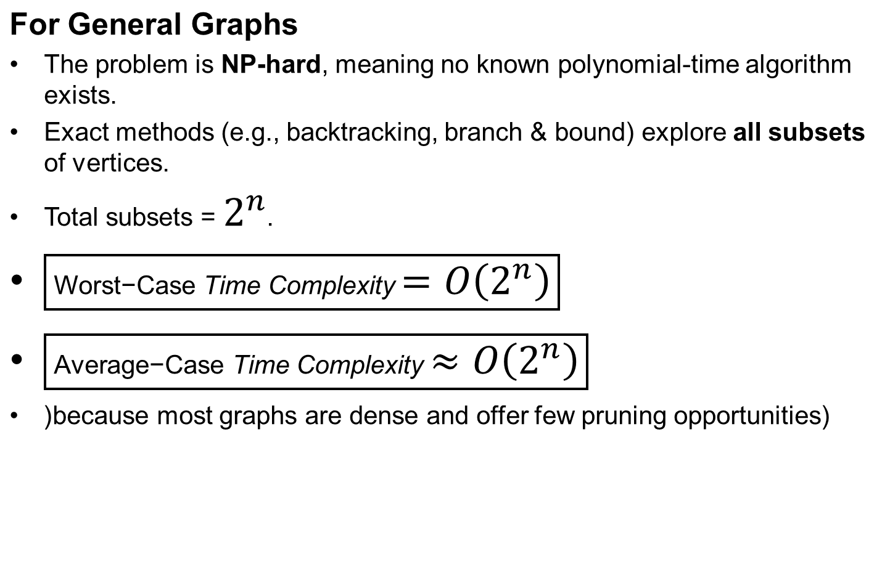
Average Case and Worst Case Running Times (MWIS)
Advanced Algorithms Analysis and Design

Slide 27
Algorithmic Paradigm
Dynamic Programming (for paths and trees).
Greedy not applicable (fails to guarantee optimality).
Approximation/heuristics for large general graphs.
Advanced Algorithms Analysis and Design

Slide 28
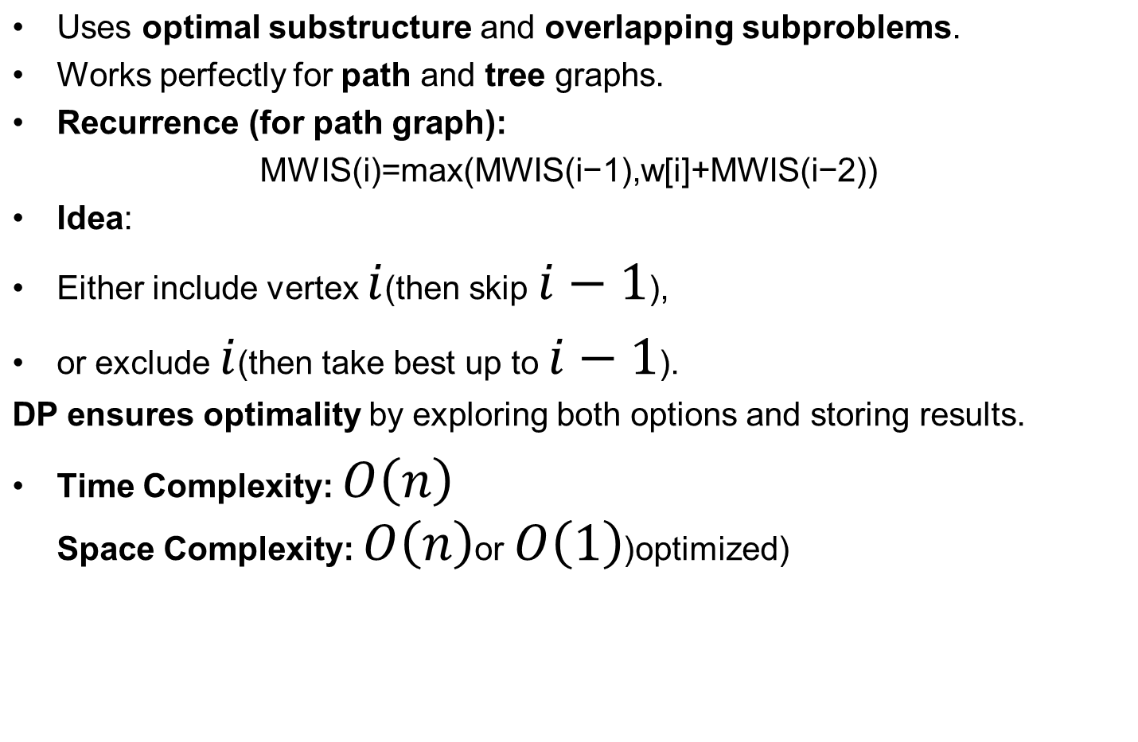
Dynamic Programming Approach
Advanced Algorithms Analysis and Design

Slide 29
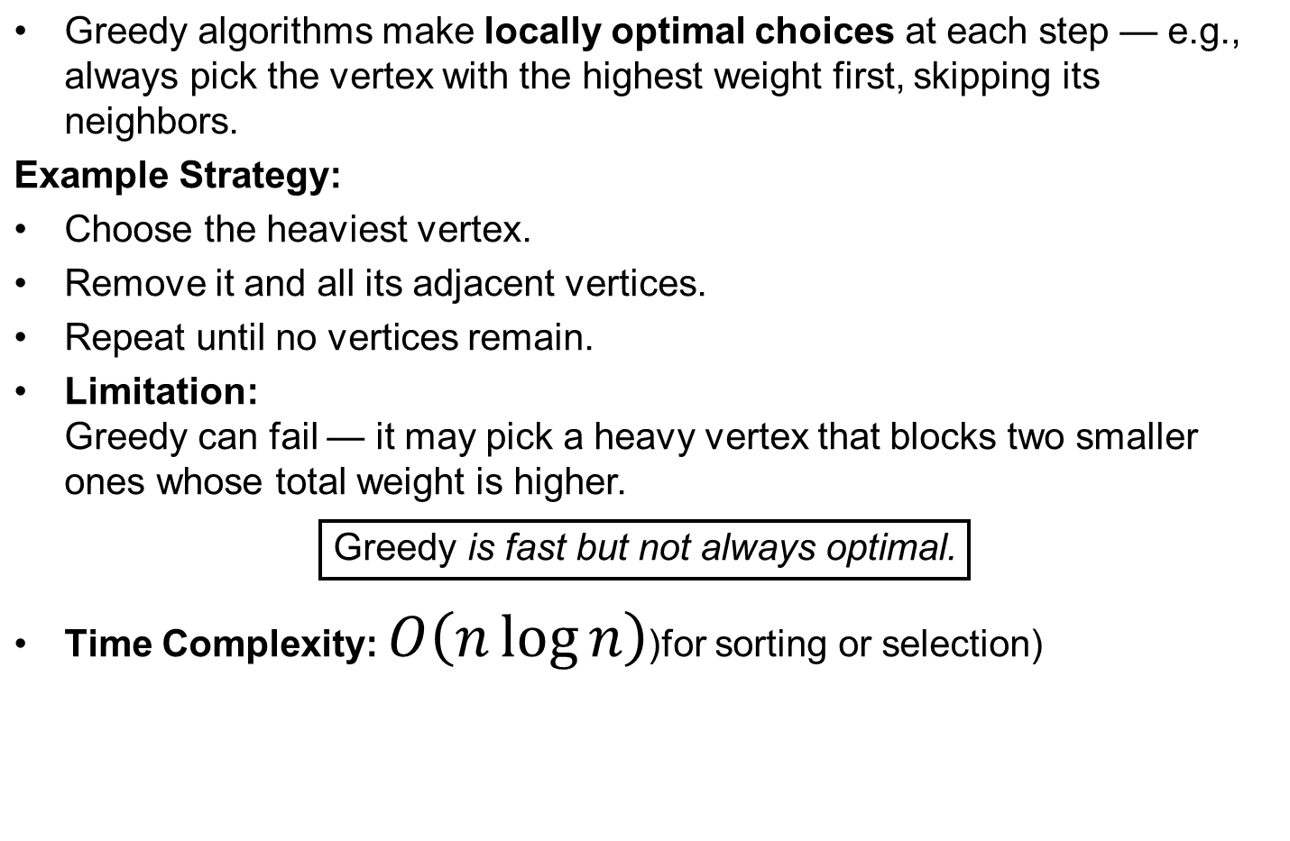
Greedy Approach
Advanced Algorithms Analysis and Design

Slide 30
Algorithmic Paradigm
Dynamic Programming (DP) → for Paths and Trees
Why DP works here:
MWIS on paths/trees has optimal substructure (solution depends on smaller subproblems).
It also has overlapping subproblems (same sub-solutions needed multiple times).
Example:
On a path:
MWIS(i)=max(MWIS(i−1),w[i]+MWIS(i−2))
Either include vertex i (skip i-1) or exclude it.
Runs in O(n) time.
On a tree:
At each node u, compute two values:
  Include(u): weight of u + exclude values of children.
  Exclude(u): sum of max(include, exclude) of children.
Advanced Algorithms Analysis and Design

Slide 31
Algorithmic Paradigm
2. Greedy Approach → Not Applicable
Greedy strategy = making the “locally best” choice at each step (e.g., always picking the vertex with the highest weight).
❌ But for MWIS, greedy fails:
Example: In a path of 3 vertices with weights A=10, B=100, C=90, greedy might choose B (highest), but the true MWIS is {A, C} = 200.
Reason: Choosing one vertex may block better combinations later → greedy doesn’t explore alternatives.
3. Approximation / Heuristics → for Large General Graphs
Since MWIS is NP-hard in general graphs, exact algorithms are too slow for large inputs.
Instead, we use:
Heuristics: practical, fast methods (like local search, simulated annealing, or greedy with adjustments) but with no guarantee of optimality.
Advanced Algorithms Analysis and Design

Slide 32
Algorithmic Paradigm
Useful in real-world applications (e.g., wireless networks, scheduling) where graphs are large and exact solutions are infeasible.
Advanced Algorithms Analysis and Design

Slide 33
Graph Theory Usage
Uses independent set property (no adjacent vertices).
Relates to:
Vertex Cover (complement of independent set in some graphs).
Clique (independent set in complement graph).
Advanced Algorithms Analysis and Design

Slide 34
Graph Theory Usage
. Independent Set Property
An independent set is a set of vertices such that no two are adjacent.
MWIS builds directly on this property:
Choose vertices with maximum total weight.
Constraint: no two chosen vertices are connected by an edge.
Graph theory provides the definition and constraints (vertex adjacency and edges).
Relation to Vertex Cover
A Vertex Cover is a set of vertices that touches every edge in the graph.
Important relationship:
In any graph, if you take the complement of a maximum independent set, you often get a minimum vertex cover (in bipartite graphs, this relationship is exact).
Example: In a bipartite graph, Kőnig’s theorem shows that:
Advanced Algorithms Analysis and Design

Slide 35
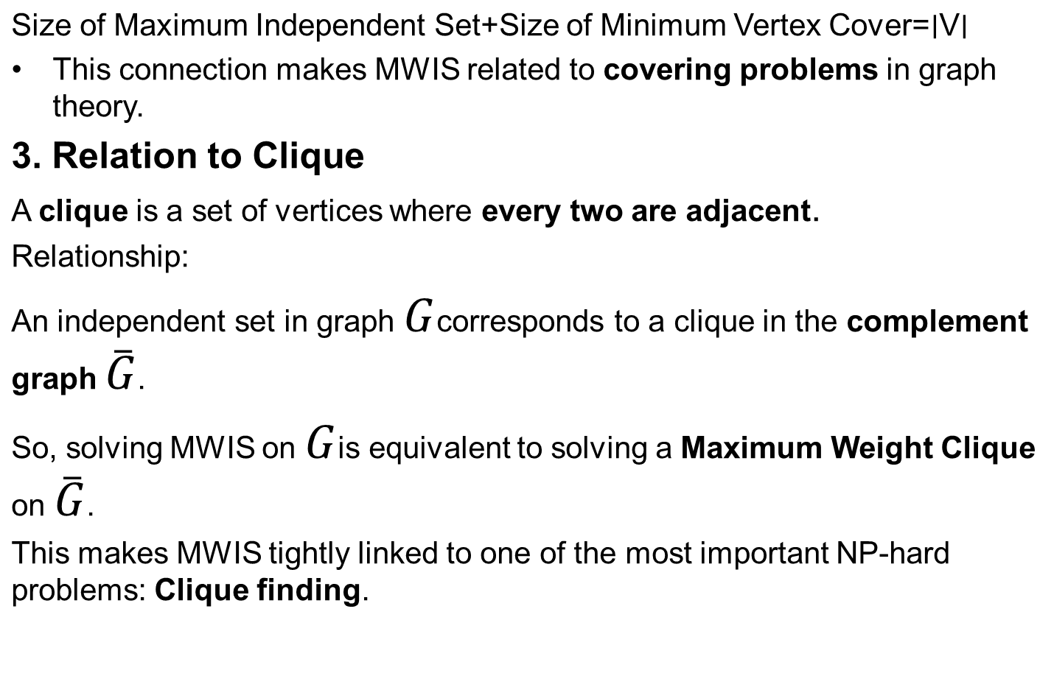
Graph Theory Usage
Advanced Algorithms Analysis and Design

Slide 36
Minimum operations add 1 multiple of 2
Advanced Algorithms Analysis and Design

Slide 37
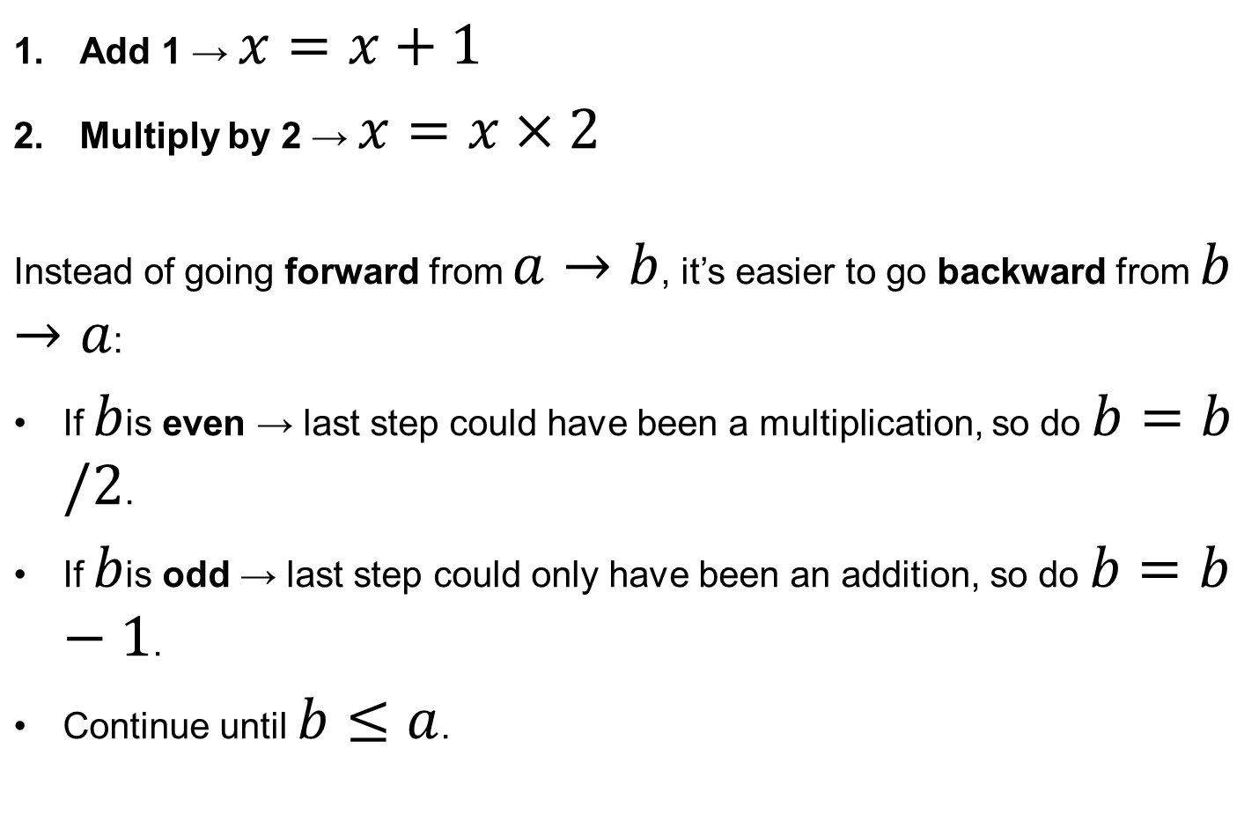
Minimum operations add 1 multiple of 2
Advanced Algorithms Analysis and Design

Slide 38
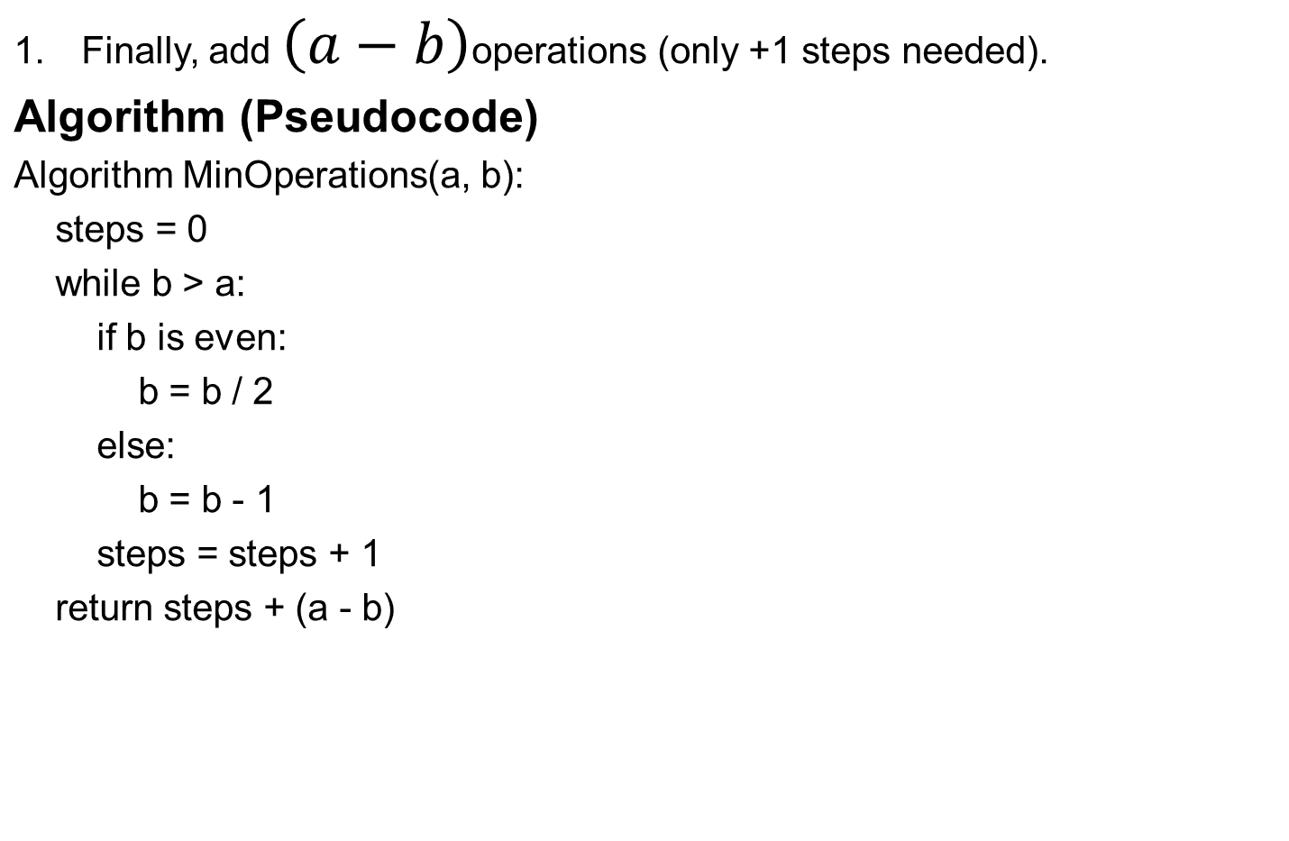
Minimum operations add 1 multiple of 2
Advanced Algorithms Analysis and Design

Slide 39
Minimum operations add 1 multiple of 2
Example 1
Start = 2, Target = 15
Reached 2 → done!
Total steps = 5
Time Complexity: O(log b)
Space Complexity: O(1)
Step | b Value | Reason | Steps
1 | 15 → 14 | (odd → -1) | 1
2 | 14 → 7 | (even → /2) | 2
3 | 7 → 6 | (odd → -1) | 3
4 | 6 → 3 | (even → /2) | 4
5 | 3 → 2 | (odd → -1) | 5
Advanced Algorithms Analysis and Design

Slide 40
Minimum operations add 1 multiple of 2
Example 2
Start = 5, Target = 19
Now b = 4 < a = 5, so add (a - b) = 1 more step.
Total steps = 5
Time Complexity: O(log b)
Space Complexity: O(1)
Step | b Value | Reason | Steps
1 | 19 → 18 | (odd → -1) | 1
2 | 18 → 9 | (even → /2) | 2
3 | 9 → 8 | (odd → -1) | 3
4 | 8 → 4 | (even → /2) | 4
Advanced Algorithms Analysis and Design

Slide 41
Correctness of algorithm
We want the minimum number of operations to convert integer a into b using:
x = x + 1
x = x * 2
implemented the reverse approach (working backward from b to a):
Algorithm MinOperations(a, b):
steps = 0
while b > a:
if b is even:
b = b / 2
else:
b = b - 1
steps = steps + 1
return steps + (a - b)
Advanced Algorithms Analysis and Design

Slide 42
Correctness of algorithm
Proof of Correctness (by Induction)
Base Case:
If b ≤ a,
we only need to perform (a - b) additions (reverse of +1),
which is trivially optimal → correct.
Inductive Hypothesis:
Assume the algorithm gives the minimal steps for all values less than b.
Advanced Algorithms Analysis and Design

Slide 43
Correctness of algorithm
Inductive Step:
For b > a:
If b is even, the optimal previous step is b/2 because reaching b from any number other than b/2 would require more steps (since doubling is the only way to get even numbers efficiently).
If b is odd, we must reach b by first making it even (b - 1), because there’s no integer x such that x * 2 = b when b is odd.
Advanced Algorithms Analysis and Design

Slide 44
Time Complexity Analysis
You are given two integers:
Start = a Target = b
Allowed operations:
Add 1 → x = x + 1
Multiply by 2 → x = x * 2
Goal: Find the minimum number of operations to reach b from a.
Advanced Algorithms Analysis and Design

Slide 45
Time Complexity Analysis
Your algorithm goes backward from b → a:
steps = 0
while b > a:
if b is even:
b = b / 2
else:
b = b - 1
steps += 1
return steps + (a - b)
Advanced Algorithms Analysis and Design

Slide 46
Time Complexity Analysis
step-by-Step Reasoning
Each iteration reduces b either by:
Dividing by 2 (if even), or
Subtracting 1 (if odd).
2. The value of b decreases at least by half every time it’s even.
So the number of divisions by 2 dominates the total count of operations.
3. The number of such divisions is approximately equal to the number of bits in b (since dividing by 2 shifts bits right).
4. Therefore, the total number of loop iterations is proportional to log₂(b).
Time complexity
T(b)=O(logb)​
Advanced Algorithms Analysis and Design

Slide 47
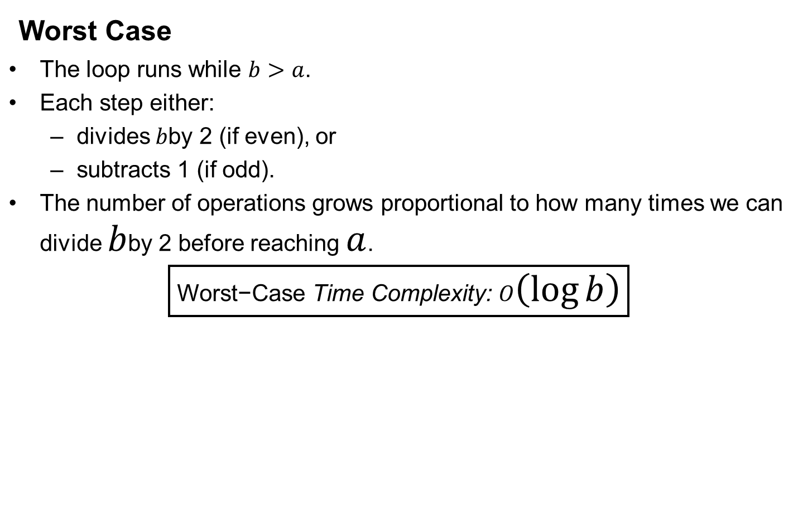
Average and Worst Case Running Times
Advanced Algorithms Analysis and Design

Slide 48
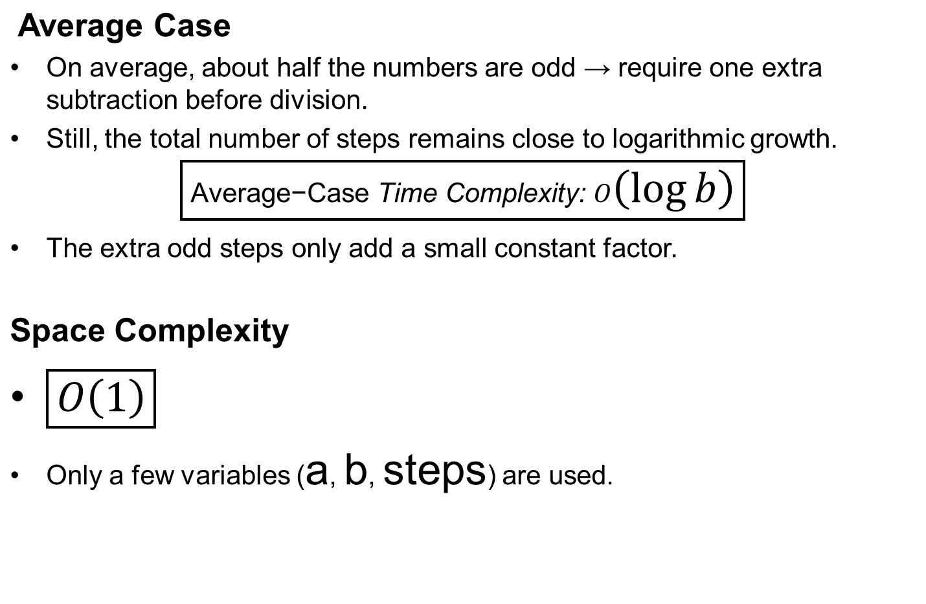
Average and Worst Case Running Times
Advanced Algorithms Analysis and Design

Slide 49
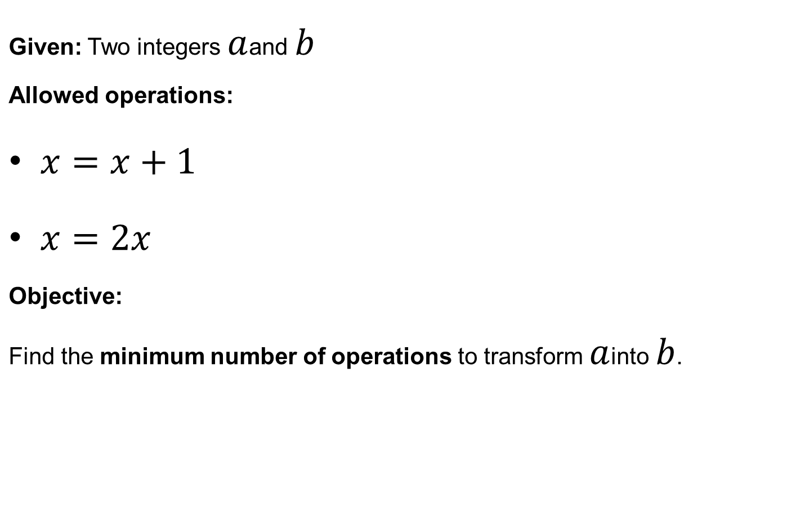
Mathematical Model of the Problem
Advanced Algorithms Analysis and Design

Slide 50
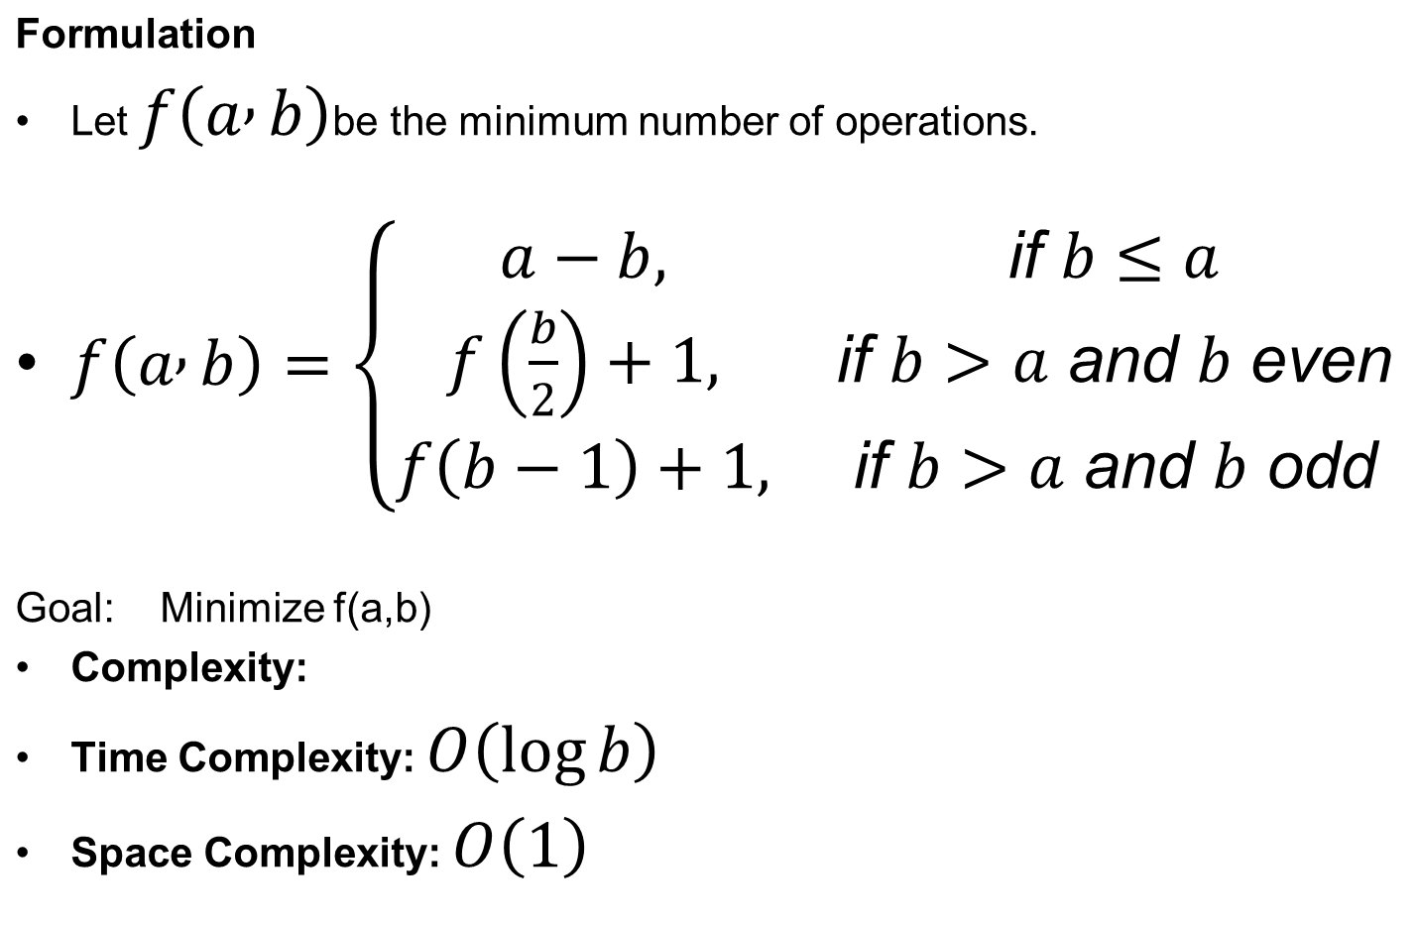
Mathematical Model of the Problem
Advanced Algorithms Analysis and Design

Slide 51
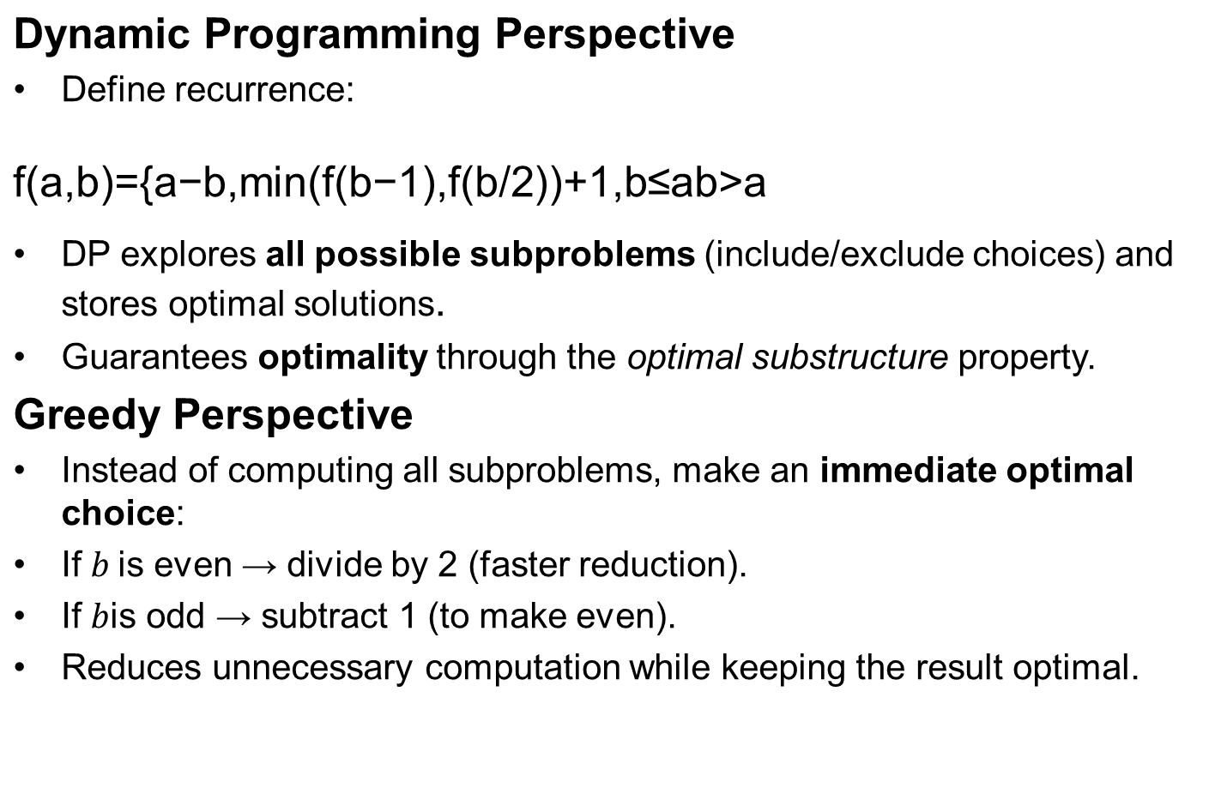
Dynamic + Greedy Algorithms
Advanced Algorithms Analysis and Design

